Slide 1
Width and Height

Slide 2
Agenda
Width and Height
Sample output
Width and Height implementation

Slide 3
Width and Height
Width and Height of the div block can be modified according to the need.
If we we do not specify width and height, necessary dimensions are auto assigned to the div block.
Syntax:
width: 200px;
height: 200px;
Or
width: 20%;
height: 20%
Or
width: 20cm;
height: 20cm;

Slide 4
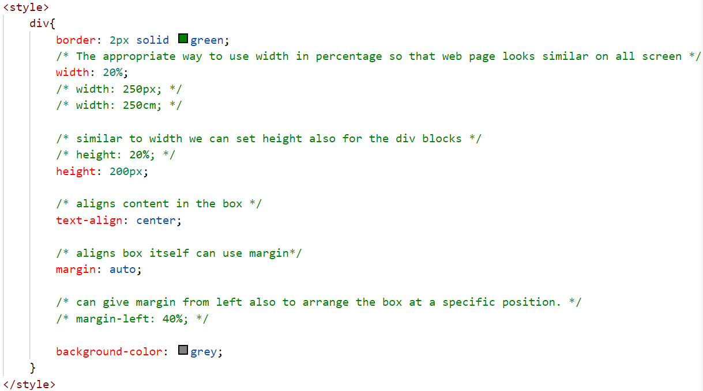
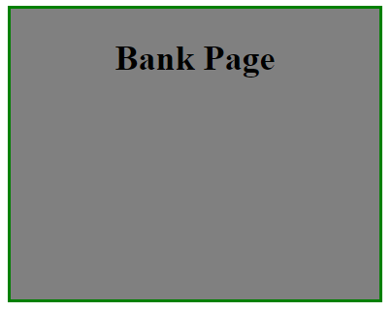
Sample output

Slide 5
Width and Height implementation
Lets see the implementation of width and height properties in div block.

Slide 6
Summary
Width and height properties are used to set the dimensions of any tag.
We have seen implementation for the same.
DO NOT WRITE ANYTHING
HERE. LEAVE THIS SPACE FOR
WEBCAM

Slide 7
Thank You
Proprietary content. ©Great Learning. All Rights Reserved. Unauthorized use or distribution prohibited

